Slide 1
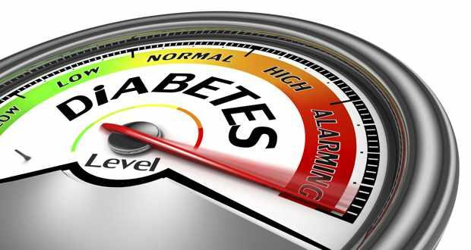
DIABETIC EMERGENCIES DIABETIC KETOACIDOSIS (DKA) and HYPEROSMOLAR HYPERGLYCAEMIC STATE (HHS)
By
Dr Shamanth Soghal
JSD FY2- Medical Rotations
Queen Elizabeth Hospital Birmingham

Slide 2
OBJECTIVES
To understand the brief pathophysiology and triggers of DKA
To know the diagnostic criteria and step by step management protocol of DKA and HHS
To be aware of the complications of DKA and HHS
THINGS NOT COVERED:
Hypoglycemia
Euglycemic DKA
Mixed Picture: DKA and HHS
Detailed Pathophysiology
Controversial Issues

Slide 3
SURVEY
PRE -SESSION QUESTIONNAIRE

Slide 4
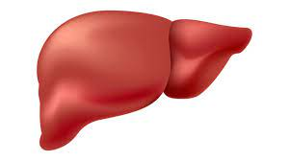
DIABETIC KETOACIDOSIS (DKA)
It is an abnormal metabolic state and a life-threatening emergency - hyperglycaemia, ketonaemia, and acidosis
Common in type 1, but about 1/3rd of cases in type 2.
Epidemiology: UK Incidence : 8.0-51.3 cases/1000 patient years in T1 DM
UK mortality rate: remains <1% , but still is the leading cause of death in people <58 years with T1DM)
PRECIPITATING FACTORS:
Missed/wrong insulin dose, poor compliance, Failure of insulin pumps
Intercurrent illness: Infection, MI, Pancreatitis
Surgery, Trauma, Pregnancy
Recreational drugs, Antipsychotics, Chemotherapy
INSULIN deficiency
Relative or absolute
Counter regulatory hormone excess
(Glucagon, cortisol, GH, catecholamines)
Glycogenolysis
Gluconeogenesis
Lipolysis ----------------> Ketoacids
--------------->
Glucose

Slide 5
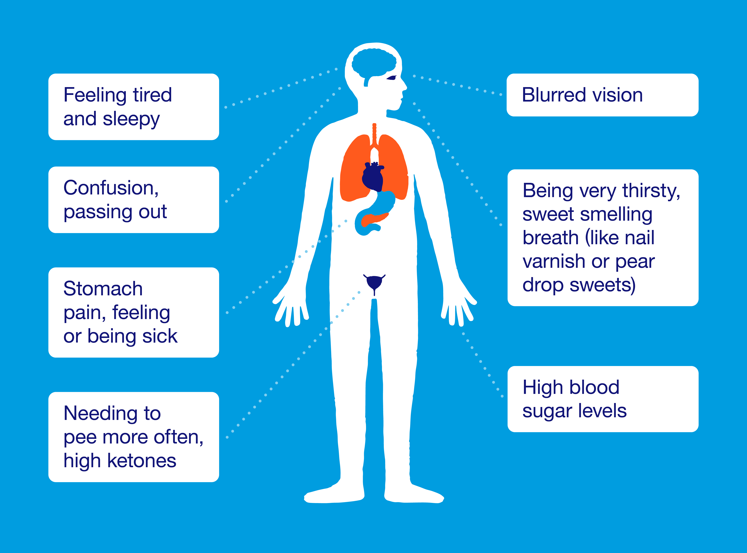
SIGNS AND SYMPTOMS

Slide 6
DIAGNOSIS
all three of the following must be present:
D • blood glucose above 11 mmol/L or known diabetic (Exception: Euglycemic DKA)
K• blood ketones >/=3 mmol/L or urine ketones >/= 2+
A• venous pH <7.3 and/or bicarbonate <15 mmol/L
Differential Diagnosis:
HHS
HHS/DKA mixed picture
Euglycemic DKA
Alcoholic Ketoacidosis
Starvational Ketoacidosis

Slide 7
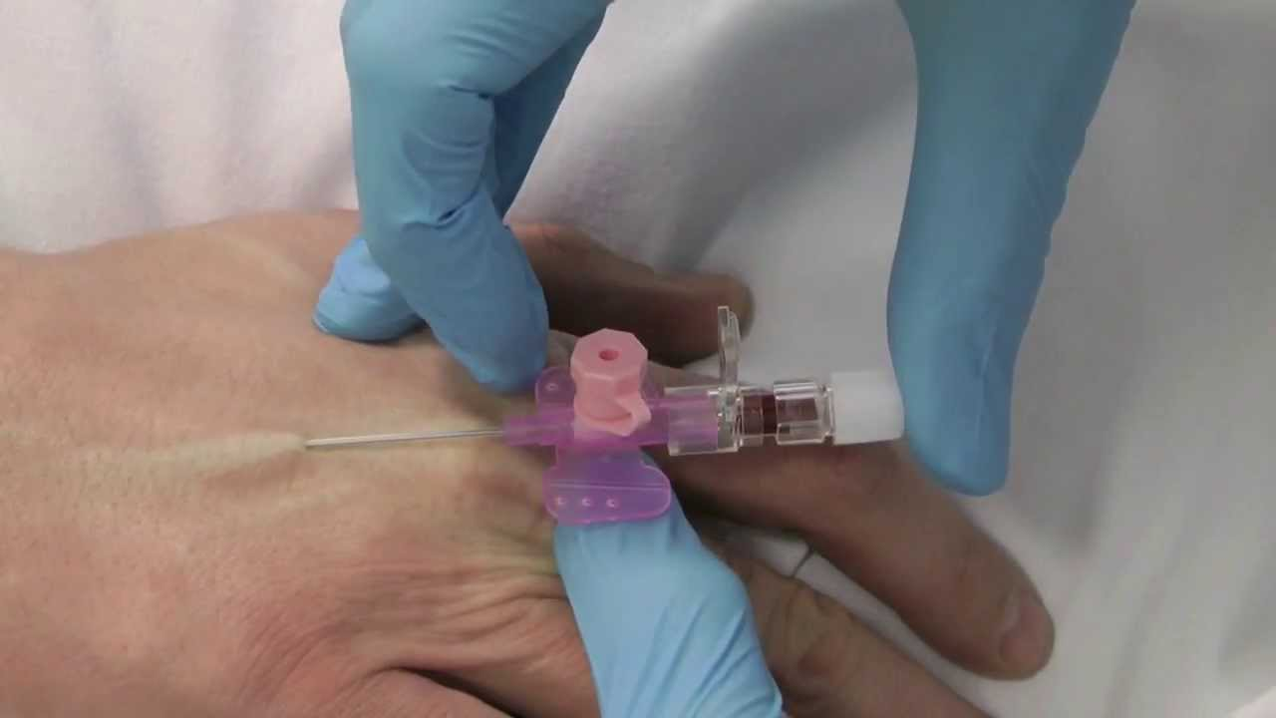
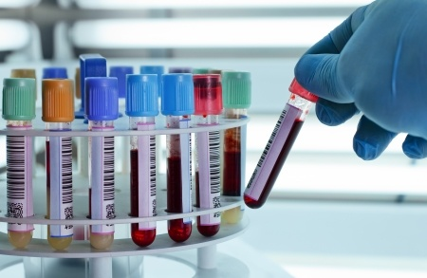
MANAGEMENT
ABCDE Approach,
2 large bore iv cannulas
Tests: VBG for pH, bicarbonate;
bedside and lab glucose and ketones; U&ES, FBC, CRP;
CXR, ECG

Slide 8
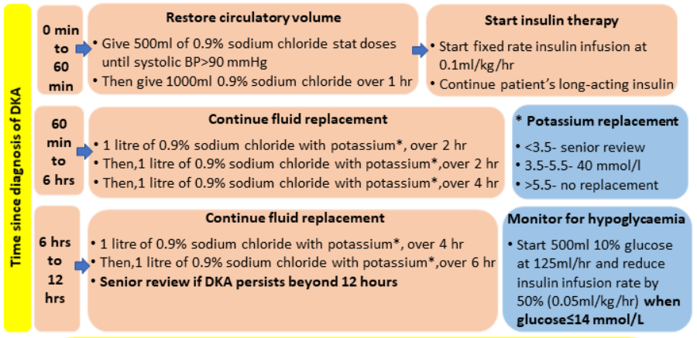

Slide 9
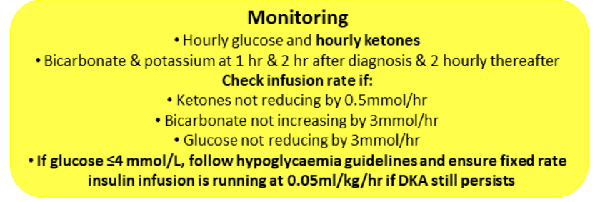
ADDITIONAL MEASURES
Consider catheter if not passed urine by 1h, aim for urine output 0.5mL/kg/h.
Consider NG tube if vomiting or drowsy
Start all patients on LMWH
Find and treat infection/cause for DKA
Bicarbonate may increase risk of cerebral oedema and is not recommended.
RESOLUTION OF DKA= Ketones < 0.6 mmol/L and venous pH > 7.3
Diabetes referral for further management and until then VRII
Expectation: Patient should be eating and drinking and back on normal insulin
Transfer to s.c insulin: Give insulin infusion until 30 minutes after s.c short acting insulin has been given

Slide 10
COMPLICATIONS
Cerebral Edema (monitor GCS, any suspicion warrants urgent imaging and antiedema measures)
Hyperkalemia and Hypokalemia
Hypoglycemia
Aspiration pneumonia
Hypomagnesaemia, Hypophosphatemia
Venous thromboembolism
Other: pulmonary edema, cardiomyopathy, rhabdomyolysis

Slide 11
HYPEROSMOLAR HYPERGLYCAEMIC STATE (HHS)
HHS is a medical emergency which is different from DKA (Previously know as HONK)
Typically occurring in T2 DM and elderly
Presentation : over many days (unlike hours in DKA), and consequently the dehydration and metabolic disturbances are more extreme.
HHS carries higher mortality risk than DKA and may be complicated by vascular events
PRECIPITATING CAUSES
Intercurrent or co-existing illness
MI/Intestinal ischaemia/PE
Infection/Sepsis/Burns/Acute abdomen/GI bleed
Stroke/TIA/ICH
Hyperthermia/Hypothermia.
AKI / Decompensated CKD
Hyperthyroidism/Cushing's syndrome/ACTH-secreting tumour.
Medication-induced
Metformin during intercurrent illness.
Diuretics
Beta-blockers, Calcium-channel blockers.
H2-receptor antagonists.
Dialysis/TPN/glucose-containing fluids.
anti-psychotics
Glucocorticoids, Phenytoin and other anticonvulsants.
Substance misuse: Alcohol, Cocaine, Amphetamines, MDMA
Diabetes-related
First presentation of diabetes mellitus:
Poor diabetic control/non-compliance:

Slide 12
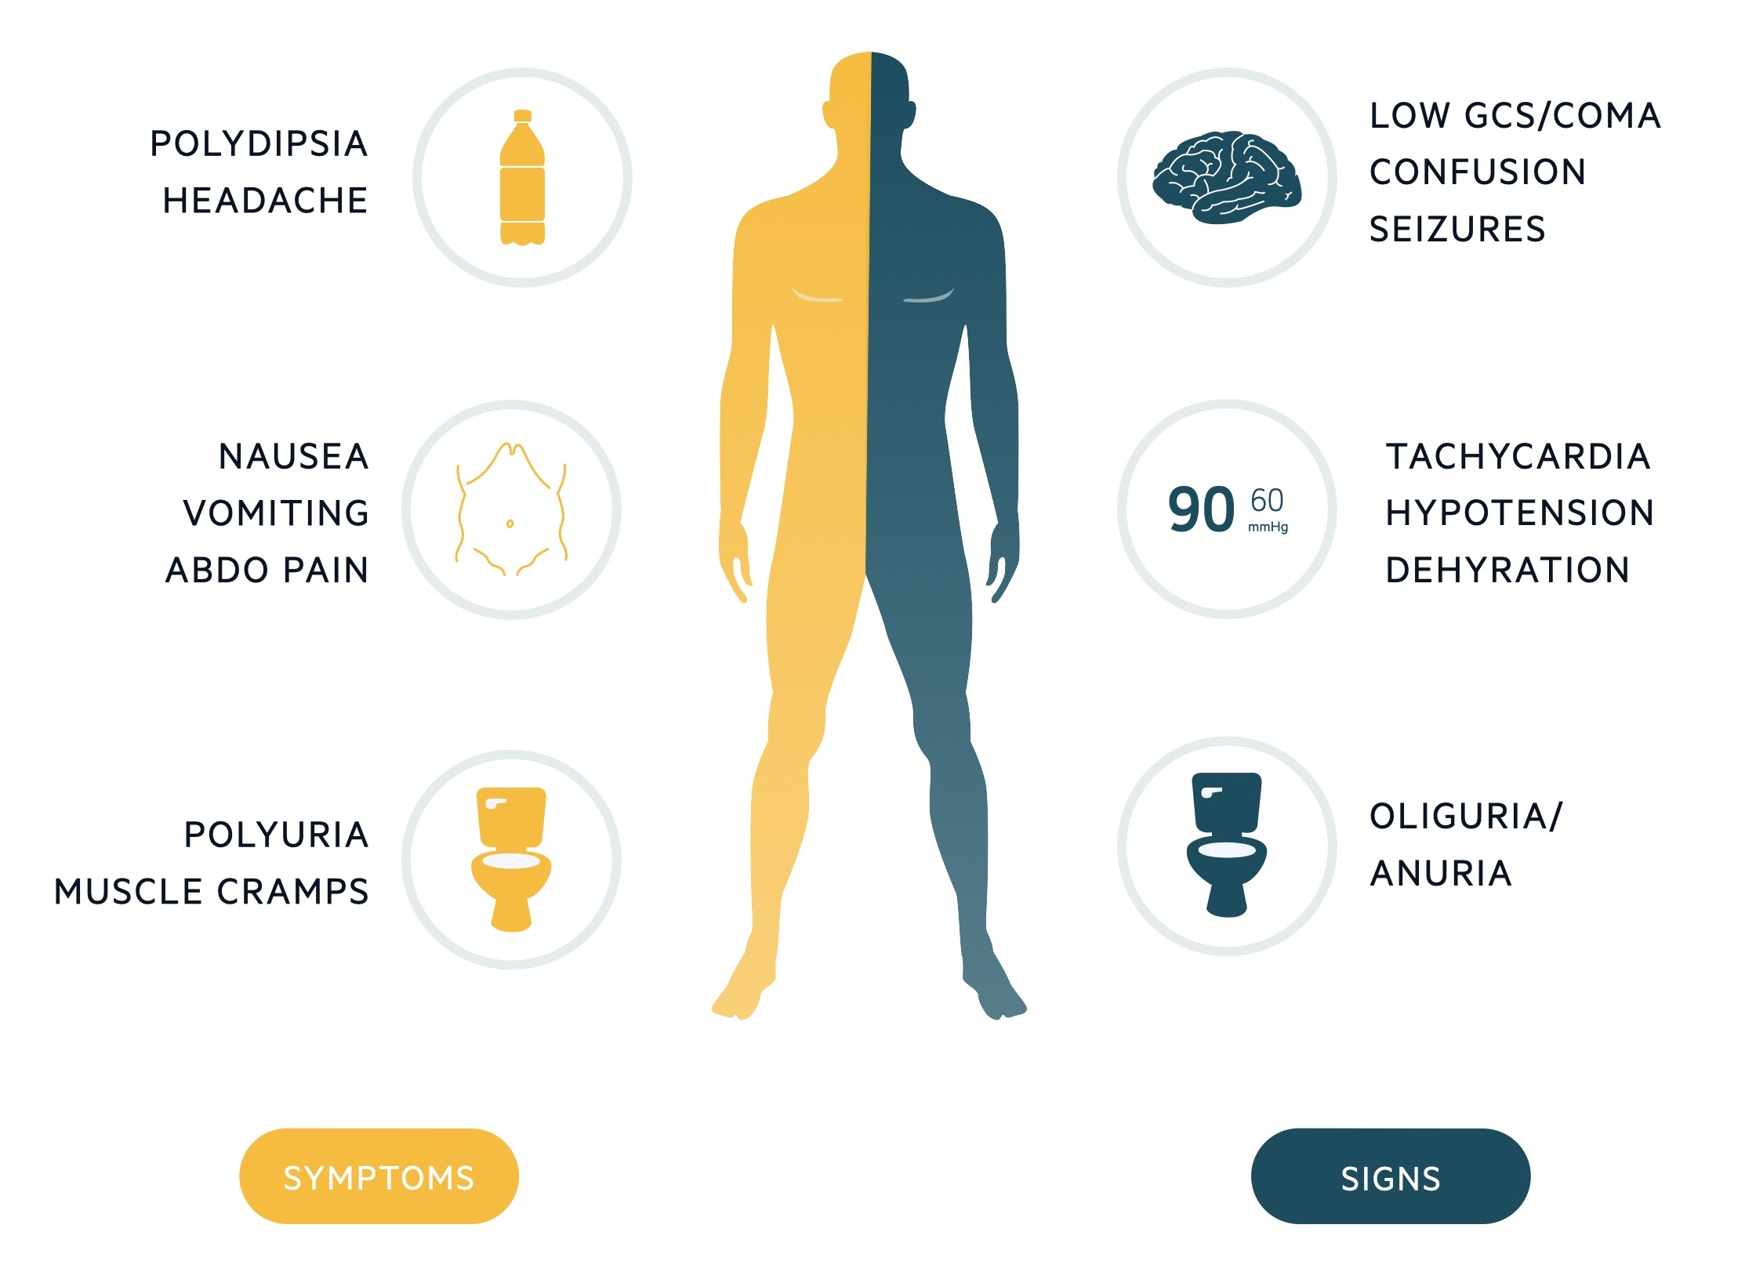

Slide 13
DIAGNOSTIC CRITERIA
• Hypovolaemia
• Marked hyperglycaemia (Glucose>/=30 mmol/L)
without significant hyperketonaemia (ketones <3 mmol/L) or
without acidosis(pH>7.3, bicarbonate >15 mmol/L)
• Osmolality >/= 320 m osmol/kg
Differential Diagnosis:
DKA
HHS/DKA mixed picture
Euglycemic DKA
Alcohlic Ketoacidosis
Starvational ketoacidosis

Slide 14
MANAGEMENT
Principles and Goals:
The underlying cause (Eg: MI, drugs, sepsis, bowel infarction)
To
Treat:
To gradually
and safely:
To
prevent
Arterial or venous thrombosis
Normalise the osmolality
Replace fluid and electrolyte losses
Normalise blood glucose
Other potential complications e.g. cerebral oedema/ central pontine myelinolysis
Foot ulceration

Slide 15
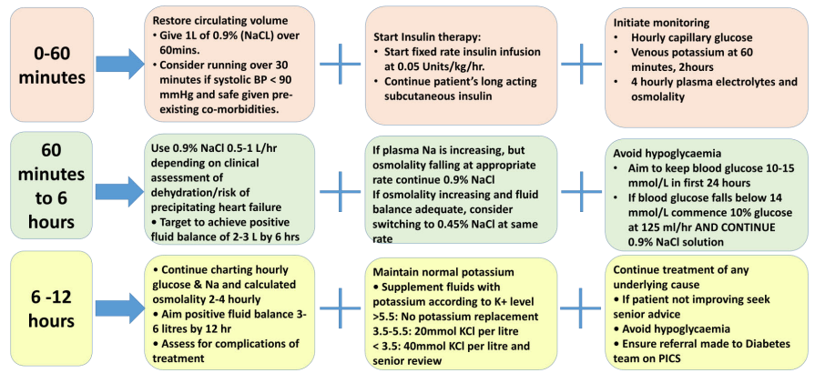
MANAGEMENT
Tests: Capillary BG, plasma BG, U&E, FBC, Measured or calculated osmolality (2Na+ glucose + urea), VBG, Blood ketones, lactate, Blood cultures, ECG, CXR, Urinalysis and culture, CRP
ABCDE Approach,
2 large bore iv cannulas
Evaluation:
Does the history suggest sepsis/vascular event or a recent change in medication?
Assess the degree of dehydration
Examine for a source of sepsis or evidence of vascular event
Mental state assessment

Slide 17
CONSIDER HDU/ITU REFERRAL
• osmolality >350 mosmol/kg
• sodium > 160 mmol/L
• venous ⁄ arterial pH < 7.1
• hypokalaemia (K<3.5 mmol/L) or hyperkalaemia (K>6 mmol/L) on admission
• GCS <12
• oxygen saturation < 92% on air (assuming normal baseline respiratory function)
• SBP < 90 mmHg
• pulse > 100 or < 60 bpm
• urine output <0.5 ml/kg/hr
• serum creatinine >200 µmol/L
• hypothermia
• macrovascular event such as MI or stroke
• other serious co-morbidity.
ADDITIONAL MEASURES IN MANAGEMENT:
Assess for: - signs of fluid overload or cerebral oedema
- evidence of continuing sepsis
- Foot (daily)
Regular monitoring : - Observations
- Plasma Osmolality
- Fluid balance (Minimum U.O 0.5 ml/kg/hr)
Consider urinary catheterisation
Measure lab glucose if bedside measurement >33mmol/L
Aim gradual decline of Plasma osmolality (3-8 mosml/kg/hour)
Diabetes team referral
Continue LMWH until day of discharge (consider extended treatment in very high risk patients)

Slide 18
COMPLICATIONS
Ischaemia or infarction affecting any organ, particularly MI and CVA
Thromboembolic disease ( DVT and PE)
ARDS
DIC
Multi-organ failure.
Rhabdomyolysis.
Cerebral oedema.
Central pontine myelinolysis.
Iatrogenic complications:
- due to inexpert rehydration and electrolyte management;
- over-administration of insulin
- fluid overload leading to cardiac failure.

Slide 19
AFTER CARE
RESOLUTION of HHS
Improvement of mental status
Blood glucose <16 mmol/L
S. Osmolality<320 mOsm/kg
Most patients should go home on subcutaneous insulin (the regime being determined by their circumstances).
For patients with previously undiagnosed DM or well controlled on oral agents, switching from insulin to the appropriate oral hypoglycaemic agent should be considered after a period of stability (weeks or months).
Ensure patient has appropriate diabetes education prior to discharge and arrange follow-up by diabetes team.

Slide 20
SURVEY
POST -SESSION QUESTIONNAIRE

Slide 21
KEY LEARNING POINTS
Referral:
- ITU if needed
- Diabetes team
Awareness of exact diagnostic criteria and following the protocol accordingly
Awareness
of complications
Early recognition is vital to prevent morbidity and mortality
Patient
Education
Differentiating and DKA and HHS

Slide 22
REFERNCES AND FURTHER READING:
Trust Guidelines
Joint British Diabetes Societies
Oxford Handbook of Clinical Medicine
https://spectrum.diabetesjournals.org

Slide 23
THANK YOU
ANY QUESTIONS?

