Slide 1
Glycaemic and safety outcomes associated with do-it-yourself artificial pancreas systems (DIYAPS): Initial insights from the Association of British Clinical Diabetologist’s (ABCD) DIYAPS audit programme
TSJ Crabtree^{1,2,3}; S Hussain^{4,5,6}; B Mendis⁷; T Gazis⁷; R Herring⁸; I Idris^{1,2}, REJ Ryder³; EG Wilmot^{1,2}
1. Department of Diabetes & Endocrinology, University Hospitals of Derby & Burton NHS Trust, UK
2. Division of Graduate Entry Medicine & Health Sciences, University of Nottingham, UK
3. Diabetes Department, City Hospital, Sandwell & West Birmingham Hospitals NHS Trust, UK
4. Department of Diabetes, School of Life Course Sciences, King’s College London,
5. Department of Diabetes and Endocrinology, Guy’s and St Thomas’ Hospital NHS Trust, London
6. Institute of Diabetes, Endocrinology and Obesity, King’s Health Partners, London
7. Diabetes Unit, Queen’s Medical Centre, Nottingham University Hospitals NHS Trust, UK
8. Centre for Endocrinology, Diabetes and Research (CEDAR), Royal Surrey NHS Foundation Trust, UK

Slide 2
Disclosures
I have received speaker fees and support to attend meetings from NovoNordisk, Abbott Diabetes Care and Sanofi

Slide 3
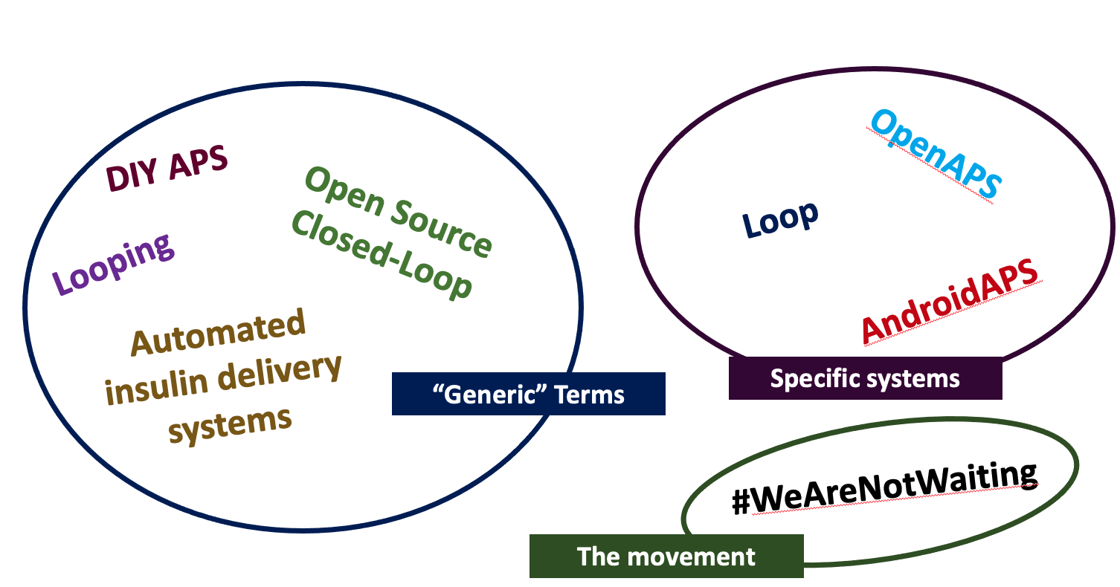
What is DIY APS?
#WeAreNotWaiting
The original: OpenAPS
Launched in 2015
Recent estimates of more than 2,500 DIY APS users globally

Slide 4
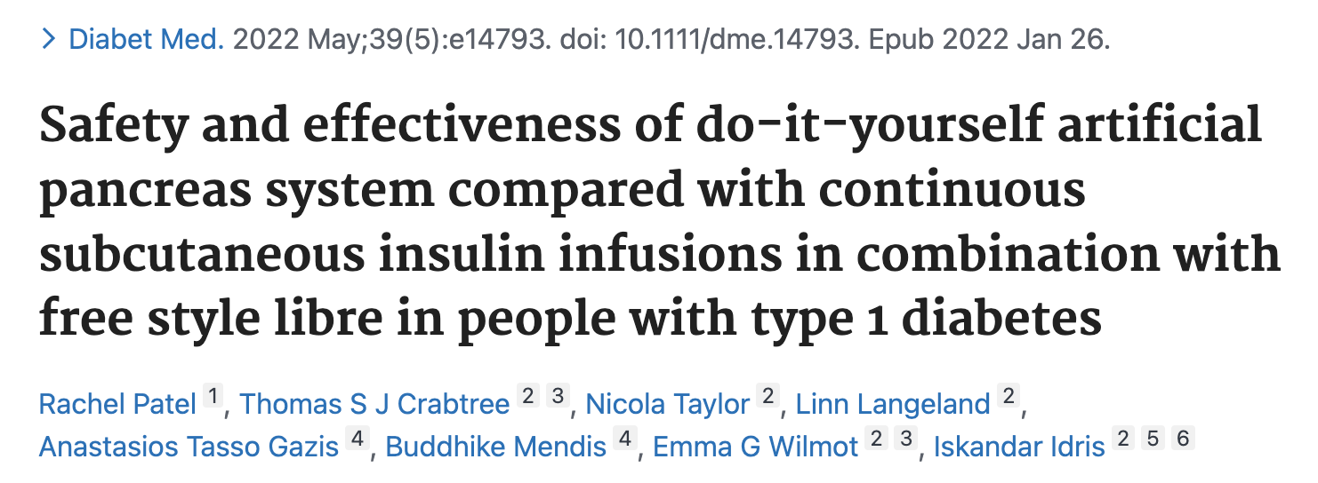
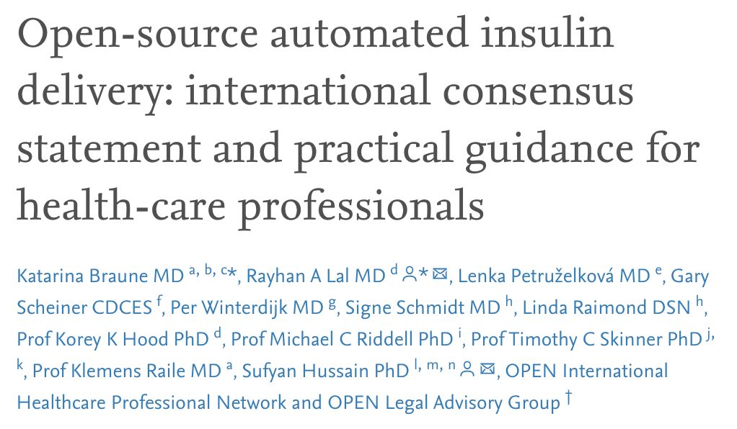
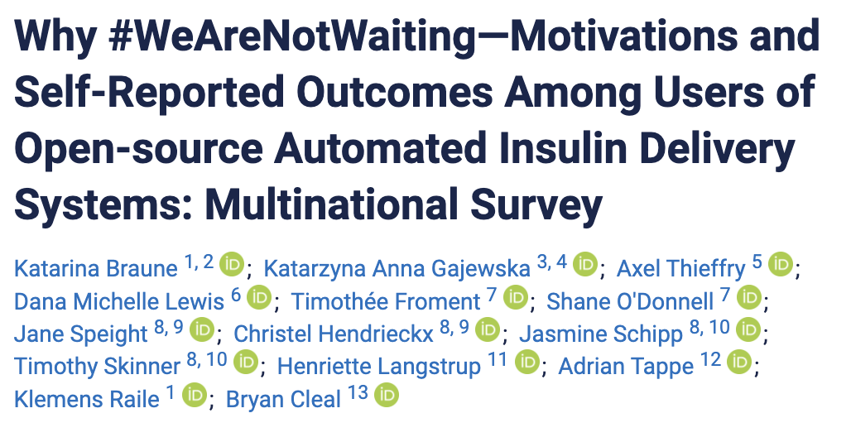
There is LOTS of evidence today…
openaps.org/outcomes

Slide 5
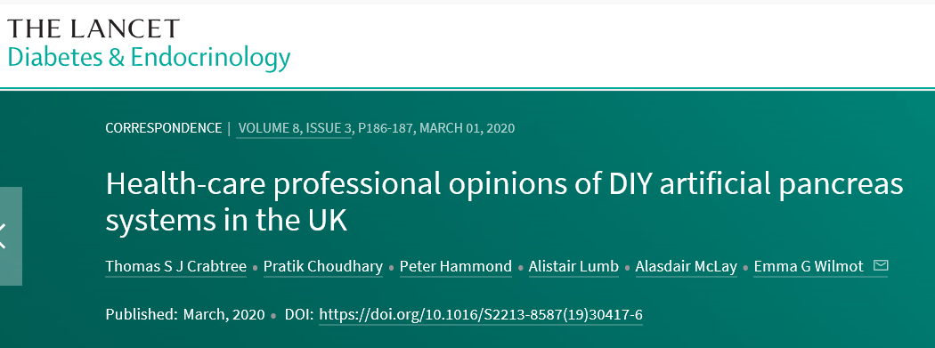
Context
Crabtree TSJ, Lancet Diabetes Endocrinol. 2020
Crabtree TSJ, Diabetes Ther. 2022.

Slide 6
Aims
The aim of the ABCD audit programme was to capture routinely recorded, clinicians verified clinical outcomes from users

Slide 7
Methods
Included in analysis: baseline (12-months prior) and follow-up data (during routine clinical care)
Outcomes to be assessed:
HbA1c
Weight
CGM metrics (TIR, TAR, TBR)
Hospital admissions & Paramedic call-outs
Adverse events
No prespecified follow-up; only available data captured
Data captured in routine clinic appointments
Upload to secure online tool
Anonymised data extracted for analysis

Slide 8
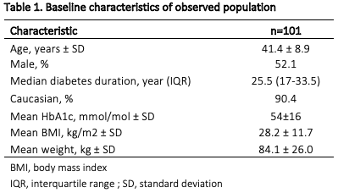
Baseline characteristics

Slide 9
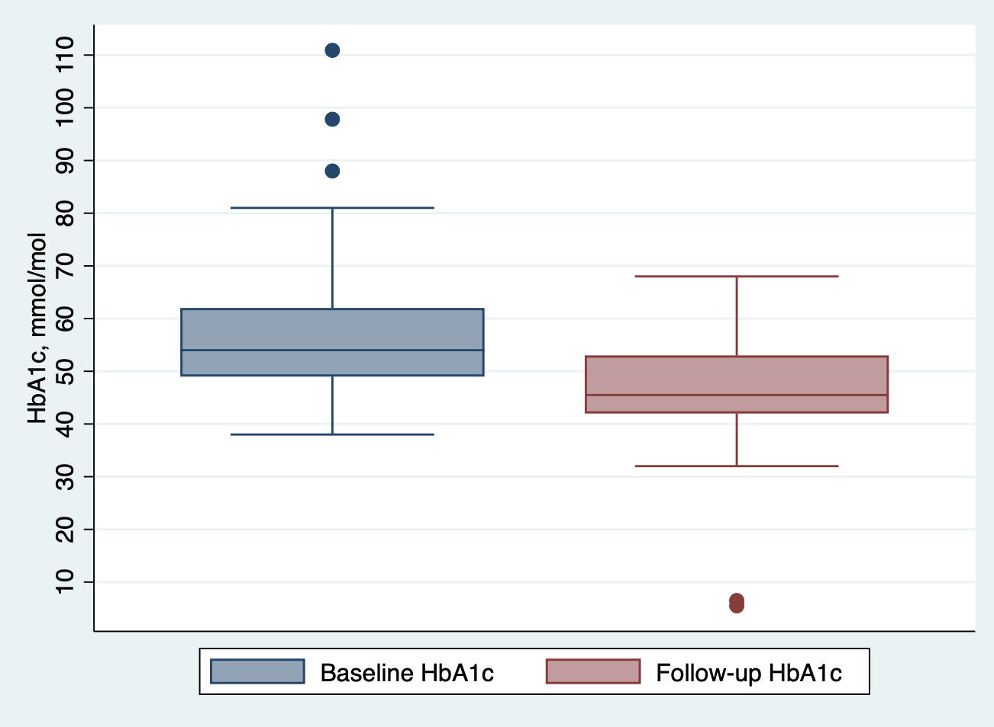
HbA1c
53.2mmol/mol→46.7mmol/mol
Difference: -6.4mmol/mol (-3.4, -9.5) P<0.0001
Mean follow-up: 1.6±1.1 years

Slide 10
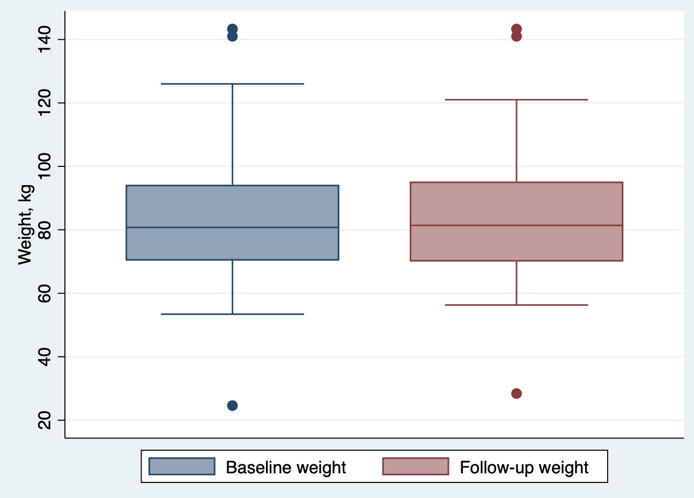
Weight
83.5kg → 84.2kg (P=0.9)
Mean follow-up: 1.6±1.1 years

Slide 11
CGM metrics
Increased TIR (p=0.046)
Trend towards decreased TBR

Slide 12
Hospital/Paramedic use/AEs
Total 7 admissions in the 12-months prior to DIYAPS
1 for hypoglycaemia
6 for diabetes related compliations
Total 3 admissions over follow-up period
2 for hypoglycaemia
1 for hyperglycaemia
No paramedic callouts not resulting in admission at baseline or follow-up
Two adverse events: 1 x app interference

Slide 13
Conclusion
Our data suggest that DIY APS use is associated with…
Increased time in range (p=0.046)
Trend towards decreased time below range (NS)
Improvement in HbA1c (p<0.0001)
No weight gain (p=0.91)
A trend towards reductions in hospital admissions (p=0.063)
Minimal adverse events
Strengths: Use of clinician verified data, will be able to compare to HCL directly within audit programme
Limitations: Real-world study design and observational data

Slide 14
Conclusion
Poster also available looking at which systems are used
Ongoing surveillance needed
New developments
Newer systems: FreeAPS, AI APS
Switch to commercial as access improves?

Slide 15
Thanks to all contributors!
England
Airedale NHS Foundation Trust, Diabetes Centre, Airedale General Hospital: Pettit A.
Cambridge University Hospitals NHS Foundation Trust, Addenbrooke's Hospital: Hartnell H.
County Durham and Darlington NHS Foundation Trust, Darlington Memorial Hospital: Humphries C.
Maidstone and Tunbridge Wells NHS Trust, Kent and Sussex Weald Diabetes Centre: Barnes D.
Nottingham University Hospitals NHS Trust, Diabetes Unit, Nottingham University Hospitals NHS Trust: Gazis T, Patel R.
Nottingham University Hospitals NHS Trust, Nottingham Children's Hospital, QMC Campus: Randell T.
Royal Surrey NHS Foundation Trust, Centre for Endocrinology, Diabetes and Research: Herring R.
Royal United Hospitals Bath NHS Foundation Trust, Royal United Hospital: Ward A.
Taunton and Somerset NHS Foundation Trust, Musgrove Park Hospital: Goodman L, Lambert P, Modgil G.
University Hospitals Birmingham NHS Foundation Trust, Good Hope Hospital: Jesson A-M.
University Hospital of Derby and Burton NHS Foundation Trust, Royal Derby Hospital: Crabtree TSJ, Peter Jennings P, Langeland L, Patel R.
University Hospitals Dorset NHS Foundation Trust, Royal Bournmouth Hospital: Partridge H.
York and Scarborough Teaching Hospitals NHS Foundation Trust, Diabetes Centre, York Hospital site: Bealey R.
Scotland
NHS Forth Valley, Forth Valley Royal Hospital: Kelly C.
Wales
Hywel Dda Health Board, Glangwili Hospital - Wales: Forrest L.
Northern Ireland
Northern Heath & Social Care Trust, Antrim Area Hospital: Kennedy A.
Western Health & Social Care Trust, Altnagelvin Area Hospital: Black N.
Spain
Hospital Santa creu i Sant Pau, Barcelona, Endocrinology Departament @ Hospital Santa creu i Sant Pau: Corcoy R, Gonzalez C.
Acknowledgment
The ABCD nationwide DIY-APS audit is an independent audit supported by an unrestricted grant from Diabetes Care Trust.
ABCD nationwide DIY-APS audit – initial setup, maintenance and nationwide analysis: Crabtree TSJ, Wilmot EG, Ryder, REJ, Cull ML.

Slide 16
Join the ABCD audits
Many of our audits welcome international participation
Closed-Loop audit
DIY APS audit
NEW: OmniPod audit
https://abcd.care/abcd-nationwide-audits
With thanks to all ABCD DIY APS audit contributors, and my supervisors Emma Wilmot, Bob Ryder and Is Idris

